Slide 1
Brief Incomplete History of Computing
ICS 111
Cam Moore
Information and Computer Sciences
University of Hawaii, Manoa

Slide 2
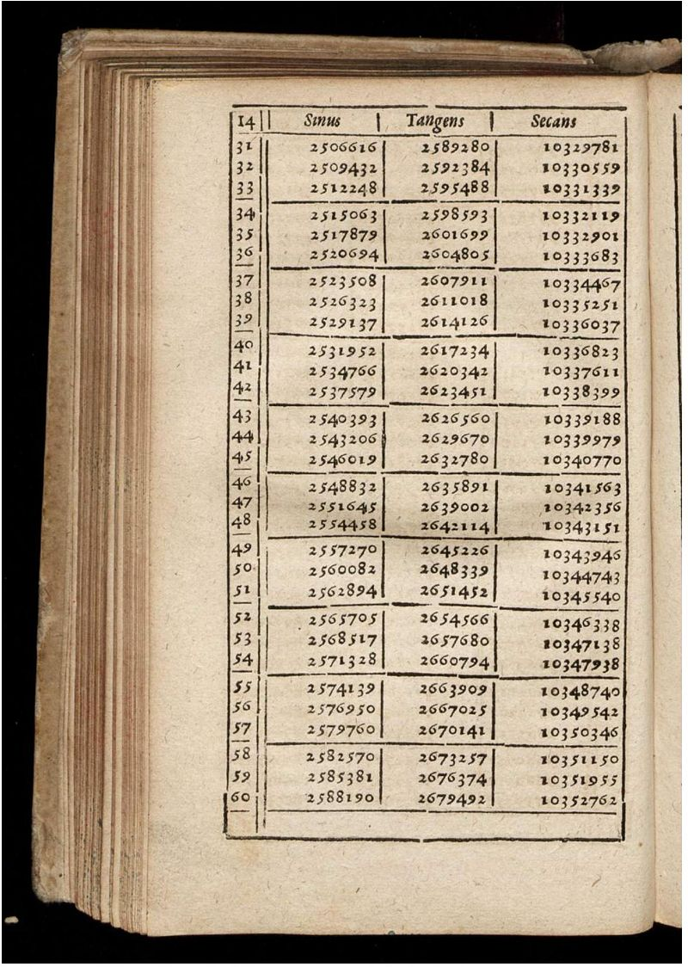
Before 17th Century
Mathematical Tables
Trigonometric functions
1600
1800
1940
1950
1960
1968
1977
1986
Now

Slide 3
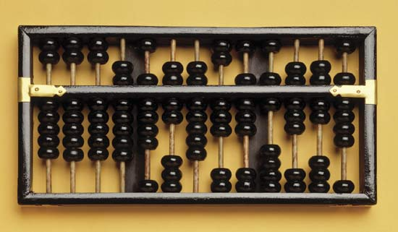
Before 17th Century
Mathematical Tables
Trigonometric functions
Abacus
Simple Operations
1600
1800
1940
1950
1960
1968
1977
1986
Now

Slide 4
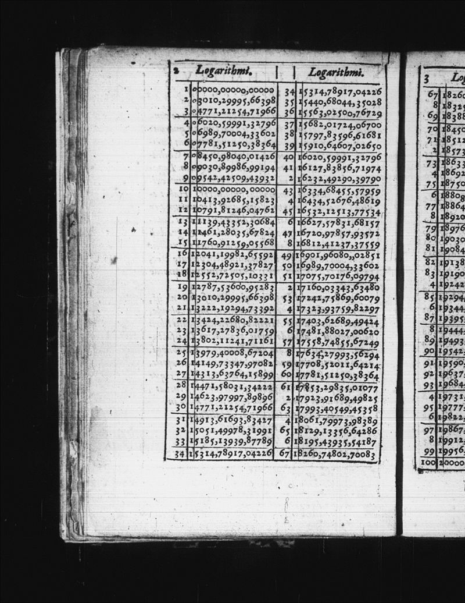
17th Century
Logarithms 1614
Simplify calculations
log(xy) = log(x) + log(y)
log(x/y) = log(x) – log(y)
log(x^{p}) = p log(x)
1600
1800
1940
1950
1960
1968
1977
1986
Now

Slide 5
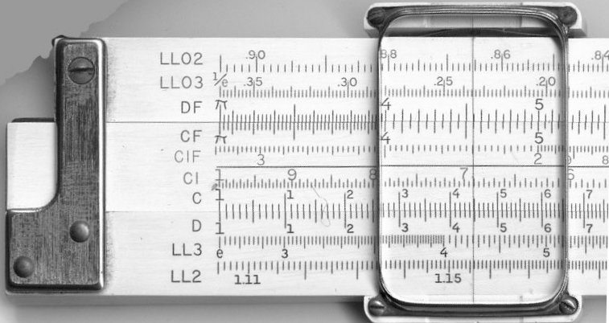
17th Century
Logarithms 1614
Simplify calculations
log(xy) = log(x) + log(y)
log(x/y) = log(x) – log(y)
log(x^{p}) = p log(x)
Slide rule
1600
1800
1940
1950
1960
1968
1977
1986
Now

Slide 6
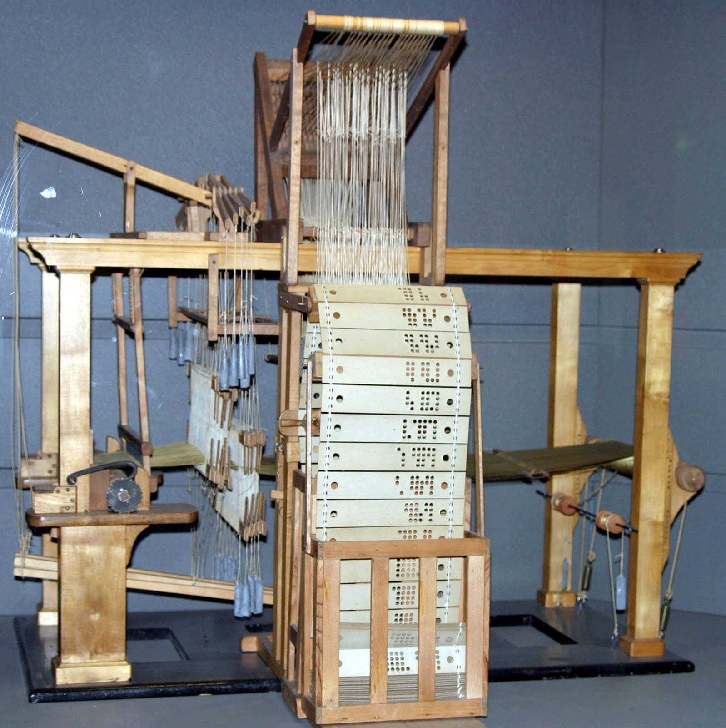
19th Century
Computer – “One who computes”
Jacquard loom
1801
Punch cards
1600
1800
1940
1950
1960
1968
1977
1986
Now

Slide 7
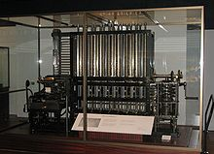
19th Century
Computer – “One who computes”
Difference Engine
Charles Babbage
1822
Eliminate human error
Compute polynomial functions
1600
1800
1940
1950
1960
1968
1977
1986
Now

Slide 8
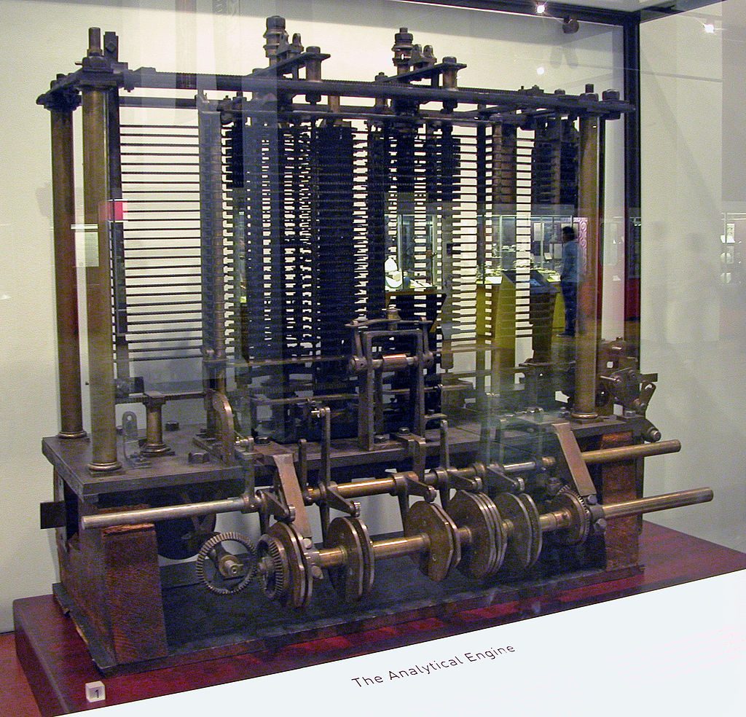
19th Century
Computer – “One who computes”
Analytical Engine
Charles Babbage
1837
First design for general purpose computer
1600
1800
1940
1950
1960
1968
1977
1986
Now

Slide 9
19th Century
Computer – “One who computes”
Mathematical Tables Project
1938 WPA project
Employed 450 clerks
1600
1800
1940
1950
1960
1968
1977
1986
Now

Slide 10
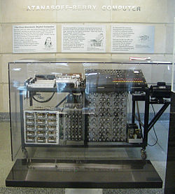
1940s
Atanasoff Berry Computer
1939-1942
First automatic electronic digital computer
Not programmable
1600
1800
1940
1950
1960
1968
1977
1986
Now

Slide 11
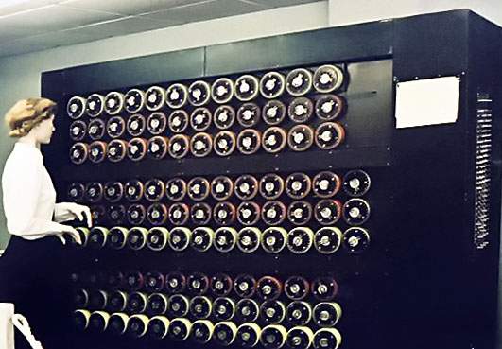
1940s
Bombe
1941
Alan Turing
Decrypt ENIGMA messages
1600
1800
1940
1950
1960
1968
1977
1986
Now

Slide 12
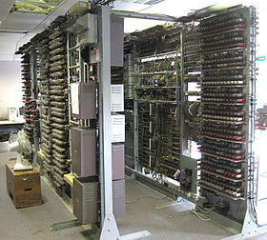
1940s
Colossus
1943
First electronic, digital, programmable, computer
Decode secret messages
Vacuum tubes
1600
1800
1940
1950
1960
1968
1977
1986
Now

Slide 13

1940s
ENIAC – Electronic Numerical Integrator And Computer
1946
First electronic general- purpose computer
Calculated artillery firing tables
30 tons 50 x 30 ft.
19000 vacuum tubes
1600
1800
1940
1950
1960
1968
1977
1986
Now

Slide 14
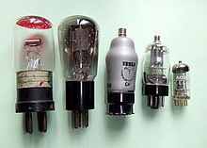
1950s
Vacuum tubes
Electronic device
Glass or steel vacuum envelop around electrodes
Uses a heating element
1600
1800
1940
1950
1960
1968
1977
1986
Now

Slide 15
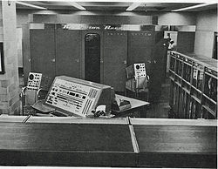
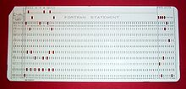
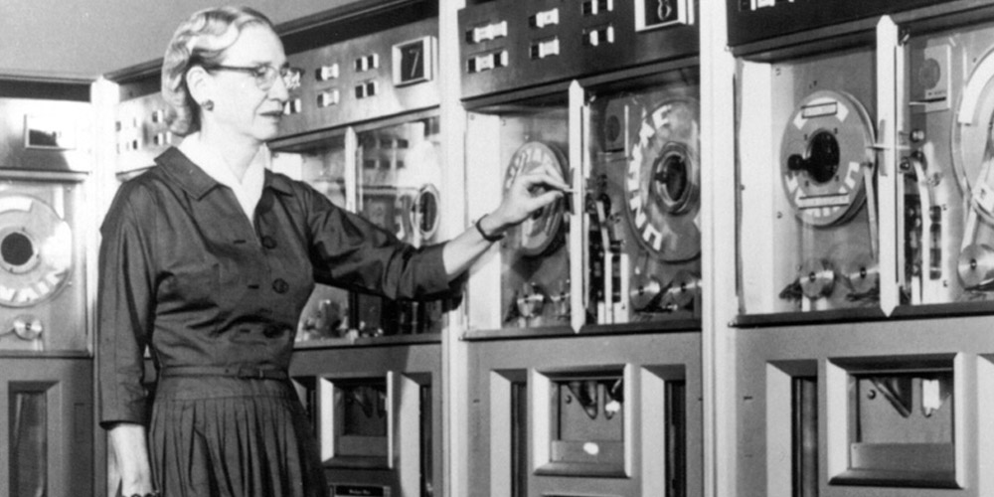
1950s
UNIVAC – UNIVersal Automatic Computer
First commercially successful computer
Punch Cards
Magnetic Tape
1600
1800
1940
1950
1960
1968
1977
1986
Now

Slide 16
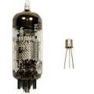
1960s
Transistors
Smaller, reduced cost more reliable than Vacuum tubes
1600
1800
1940
1950
1960
1968
1977
1986
Now

Slide 17
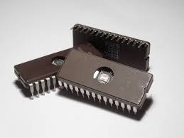
1970s
Integrated Circuits (ICs)
Intel 4004
DEC PDP-8
Cray 1
75MHz, 64-bit, 160 Mflops
Apple I
1600
1800
1940
1950
1960
1968
1977
1986
Now

Slide 18

1980s
Large Scale Integration (LSI)
Workstations
IBM PCs
Apple Macintosh
1600
1800
1940
1950
1960
1968
1977
1986
Now

Slide 19
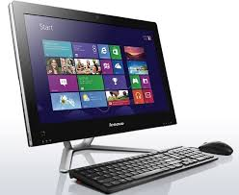

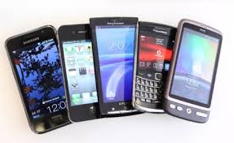
Now
Internet
Mobile
1600
1800
1940
1950
1960
1968
1977
1986
Now

